Slide 1
«Social and economic reintegration of returning labor migrants»
OPEN SOCIETY INSTITUTE ASSISTANCE FOUNDATION – TAJIKISTAN
Amsterdam, 26 July 2018
AIDS2018

Slide 2
Current situation and problems
Chronic and infectious diseases, including HIV and TB
Deportation of labor migrants (women)
Fertile age
Independent housekeeping (without support from the husband)
Domestic, social, medical and legal problems after returning from labor migration
Stigma and discrimination based on gender
Notes:
.

Slide 3
Project:
«Social and economic reintegration of returning labor migrants»
Donor:
Open Society Institute Assistance Foundation – Tajikistan
Project period:
12 months (from November 1, 2016 until October 31, 2017).
Geographic area:
Khatlon region: Bokhtar city, Levakand city, Nosiri Khisrav district

Slide 4
Overall objective:
"Reducing social, medical, legal and economic consequences in the lives of women returning from labor migration or deported from the Russian Federation“
Objectives:
Expand access to health services for vulnerable women and women of fertile age returning from labor migration.
To increase the social, legal and economic awareness of vulnerable women who have returned from labor migration.

Slide 5
Target group
1. Women who returned from labor migration due to:
deportation;
chronic diseases;
2. Women who independently lead households (single mothers, widows);
3. Women of childbearing age

Slide 6
Main activities
Dissemination of IECs;
Assistance in diagnosis and treatment of gynecological diseases, HIV, TB and STI;
Awareness rising of women about their rights and opportunities to receive social benefits;
Distribution of leaflets with information on institutions providing legal, socio-economic services, vocational education and financial support;
Assistance in professional orientation;
Organization of trainings on the basics of entrepreneurship;
Assistance in obtaining information about micro-loan funds.

Slide 7
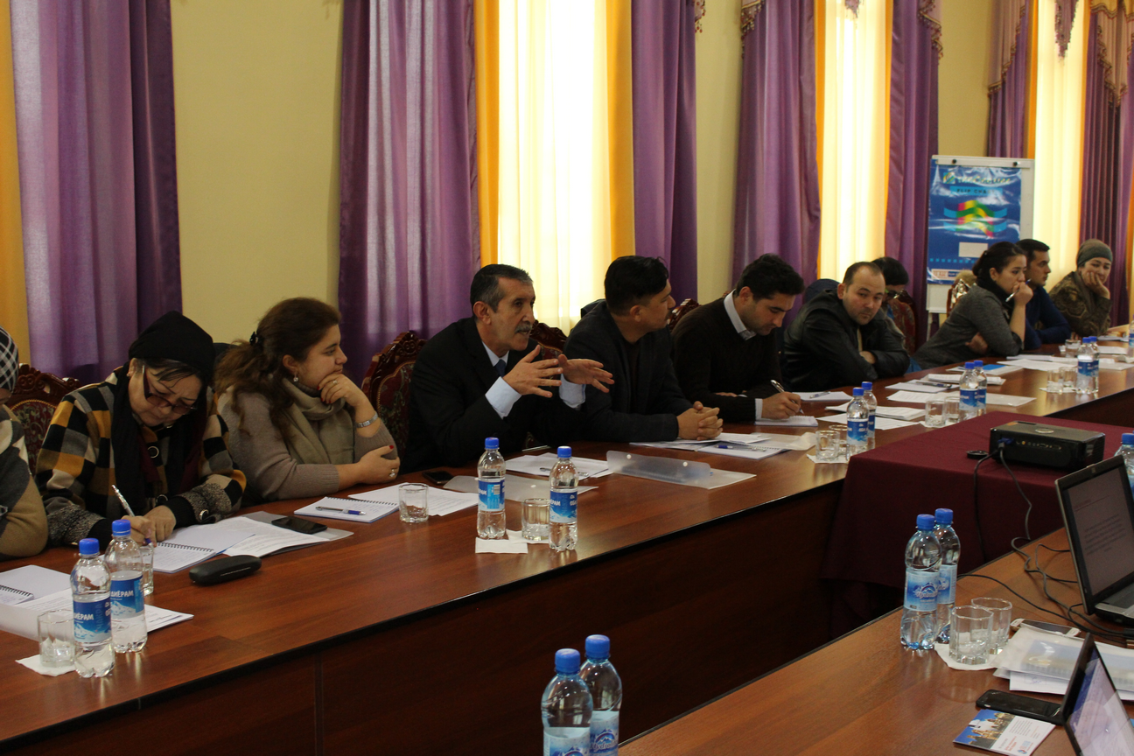
Project results
Signed agreement with 47 service providers on cooperation in provision of preventive, information-educational, sanitary-educational, legal and social services for vulnerable women.
Notes:
December 16, 2016 in Bokhtar, a working meeting was held on discussion of ways of interaction in the provision of services within the project.
As a result of the working meeting, AFEW-Tajikistan signed the Agreement on the cooperation in the provision of preventive, educational, health education and social services for vulnerable groups of the population with 47 organizations.
Out of the 47 organizations participating in the agreement, 27 partners are state institutions, 2 correctional institutions, 16 public organizations of Khatlon oblast, Dushanbe and Khujand, and 2 microfinance organizations.
The signed agreement allowed AFEW-Tajikistan to provide and expand access to medical, social, economic and legal services for women returning from labor migration to the project regions of Khatlon region

Slide 8
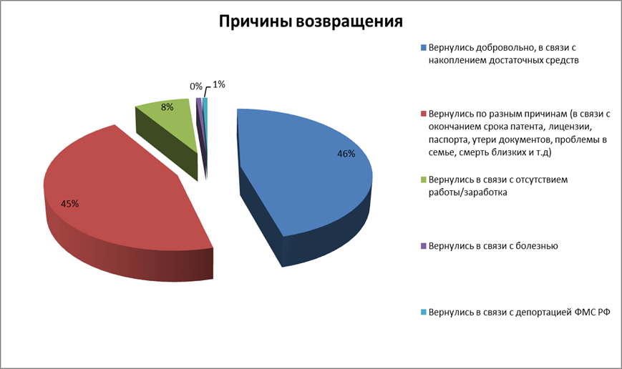
Project results
2002 women who returned from labor migration are covered by medical, social, educational, legal and economic services

Slide 9
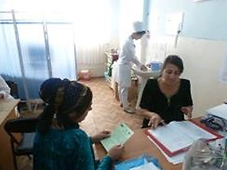
569 vulnerable women participated in information sessions on sexual, reproductive health and family planning and received consultation of a gynecologist
1142 women underwent medical examinations (2 cases of viral hepatitis were detected);
93 women received treatment.

Slide 10
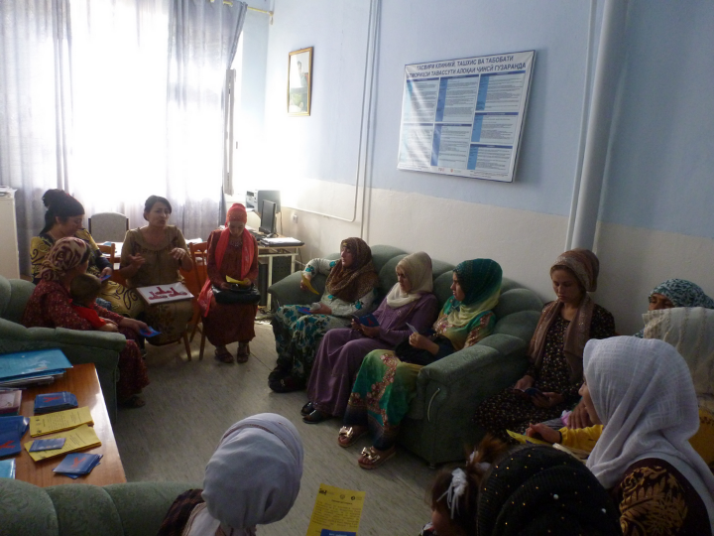
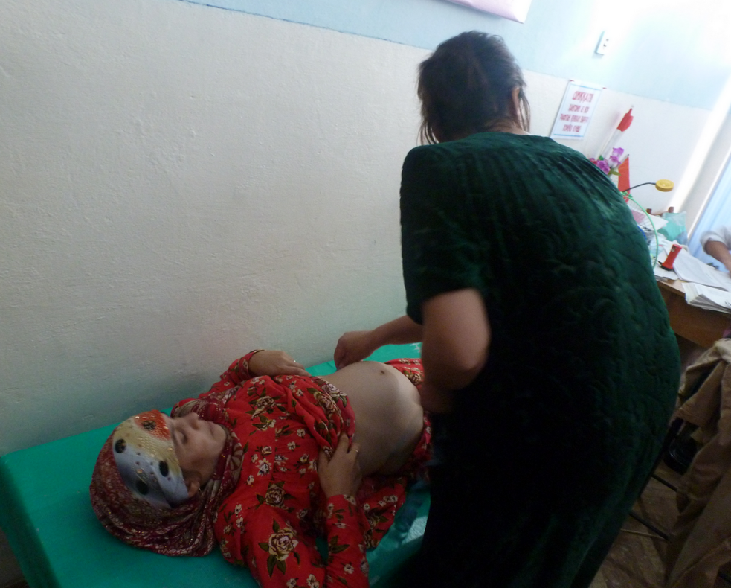
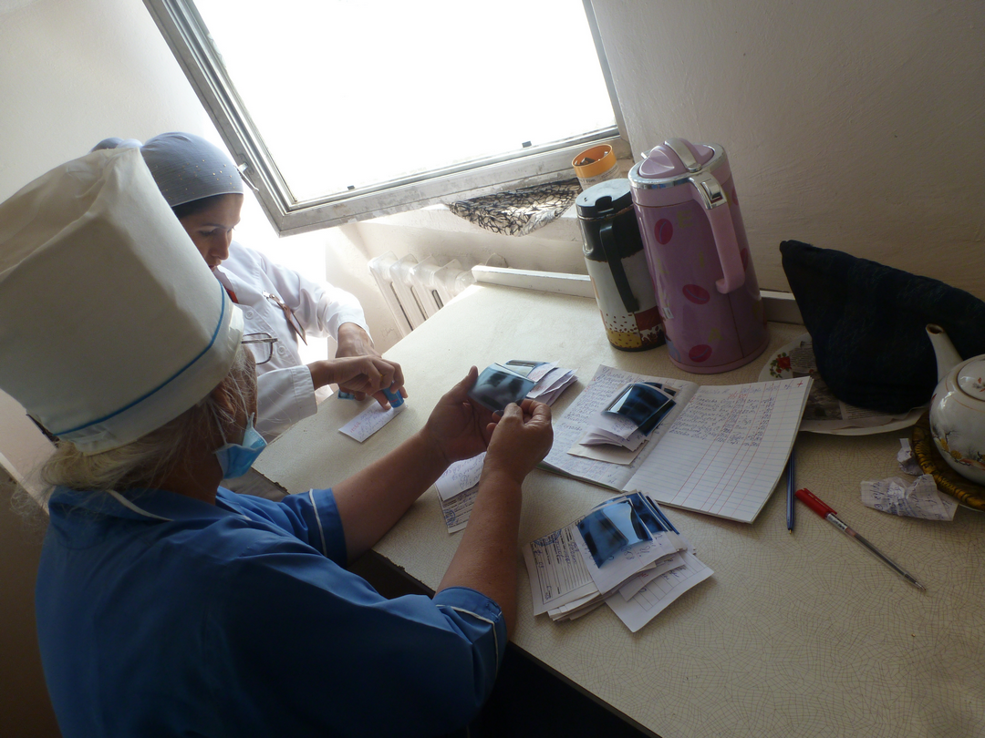
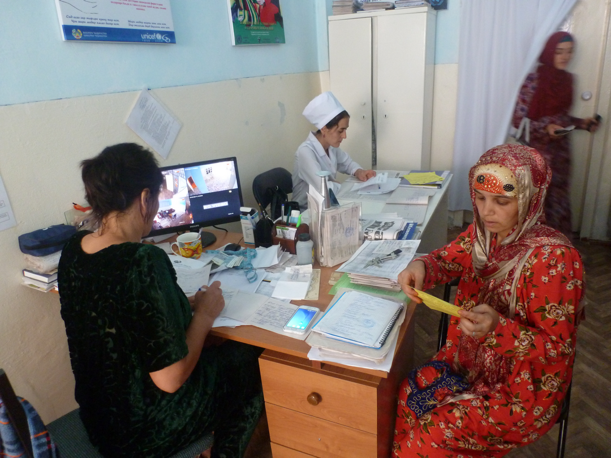
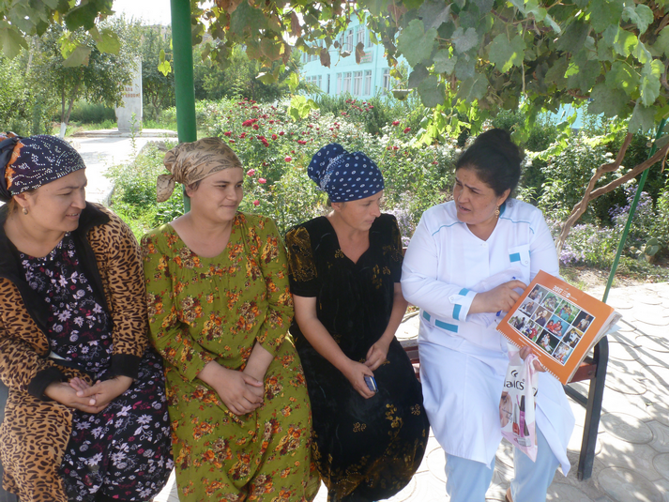
Notes:
569 vulnerable women participated in information sessions on sexual, reproductive health and family planning and received Consultation of a gynecologist
2002, women have information and can apply to services that provide legal and social support, economic education and professional orientation services

Slide 11
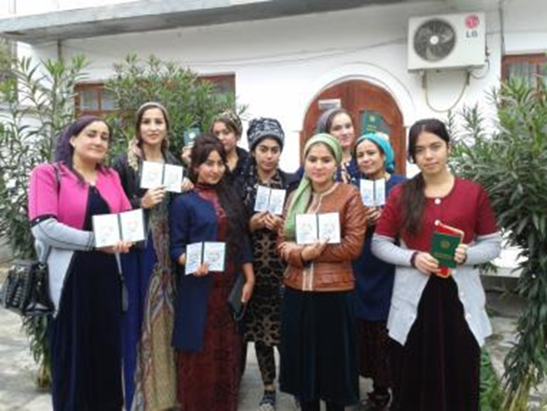
Project results
24 women completed sewing courses
23 women completed computer literacy courses.
80 women participated in the training "Basics of Business".
18 women run business at home, 4 get a job in the sewing workshop and 5 work in the trading markets.

Slide 12
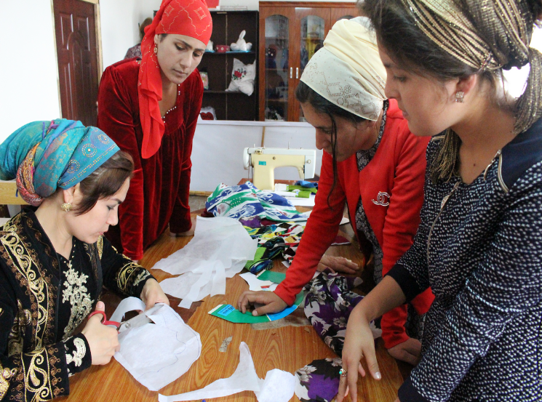
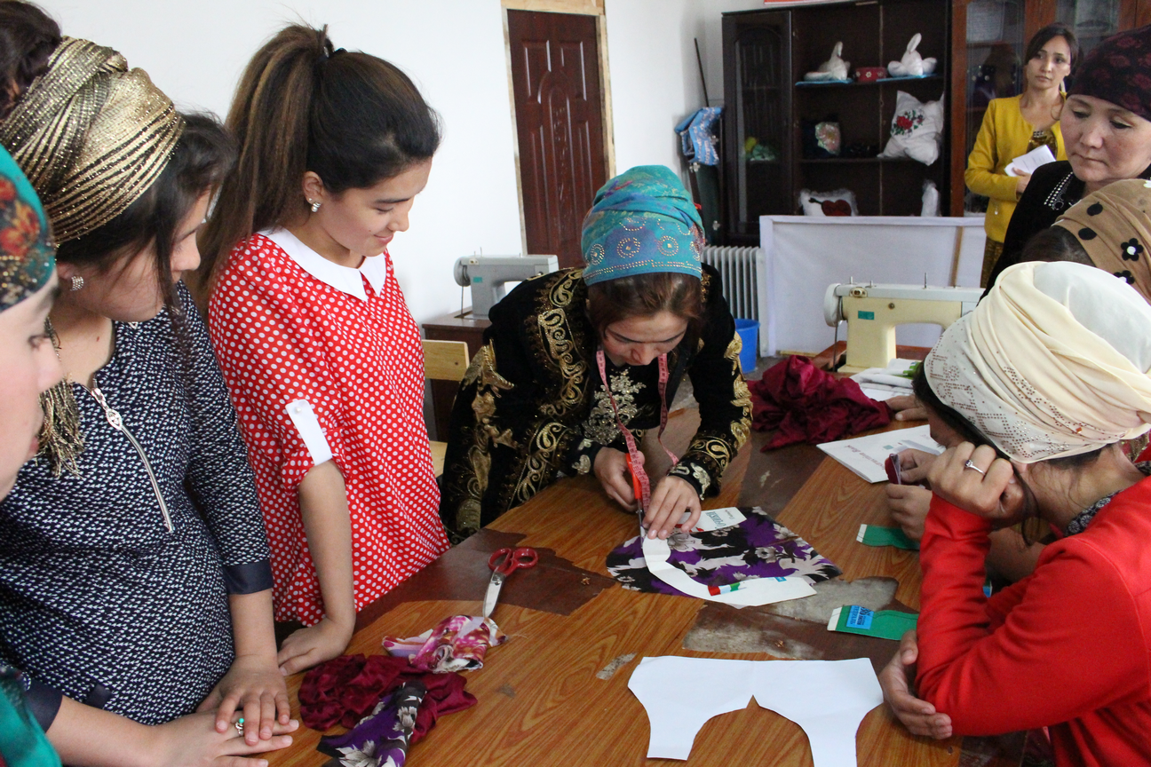
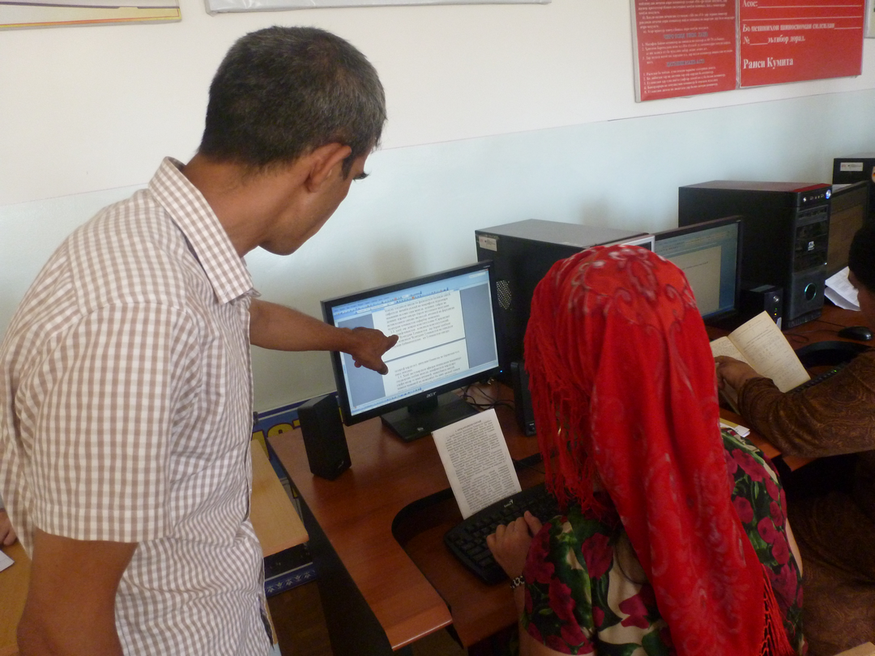
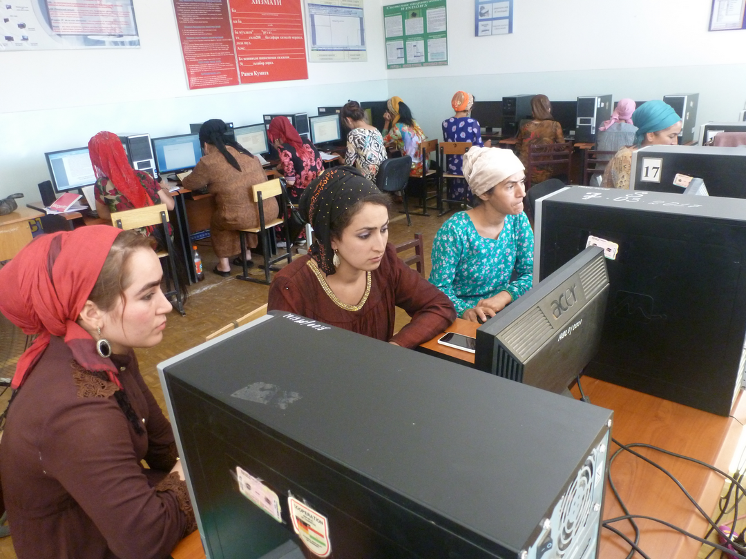
Project results

Slide 13
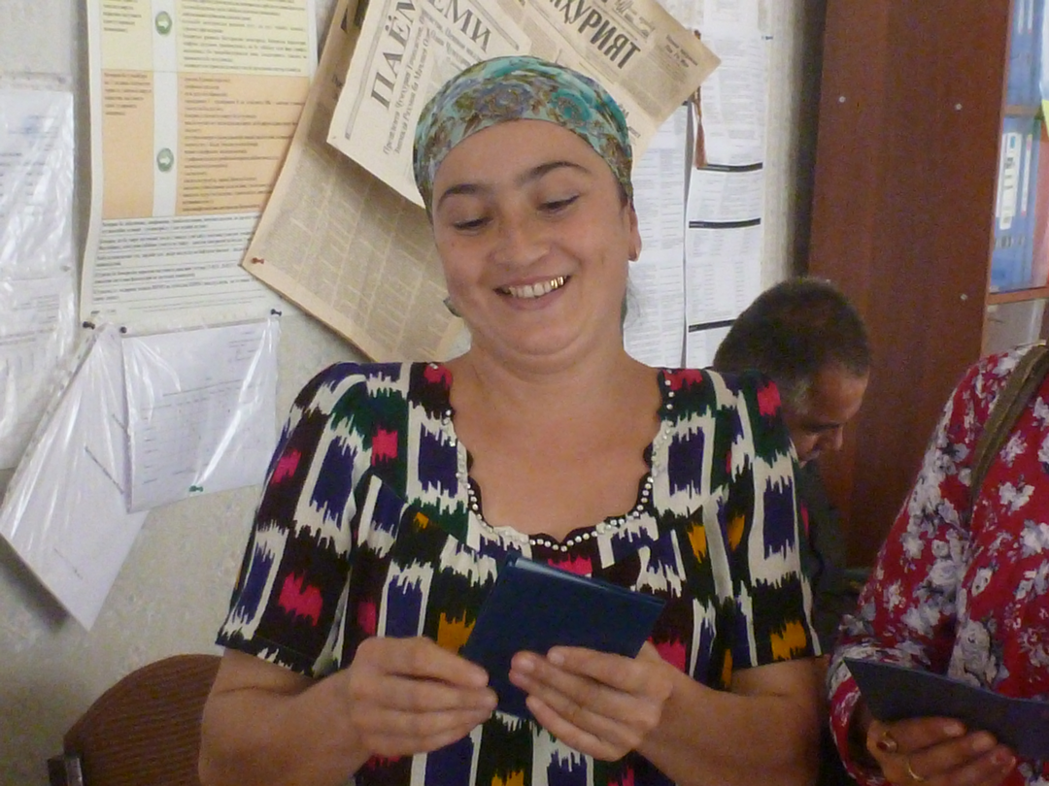
Women received the following services:
Consultations of lawyer
Restoration of the passports
Provision of food packages and medicine for the most vulnerable women

Slide 14
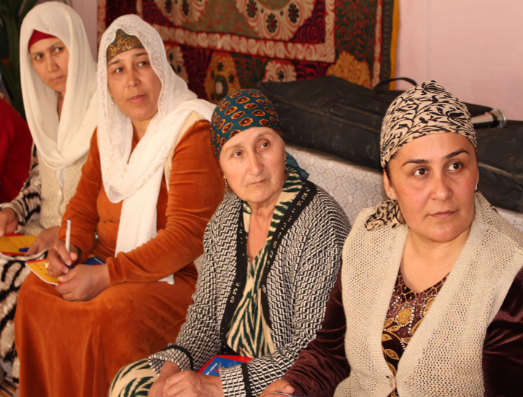
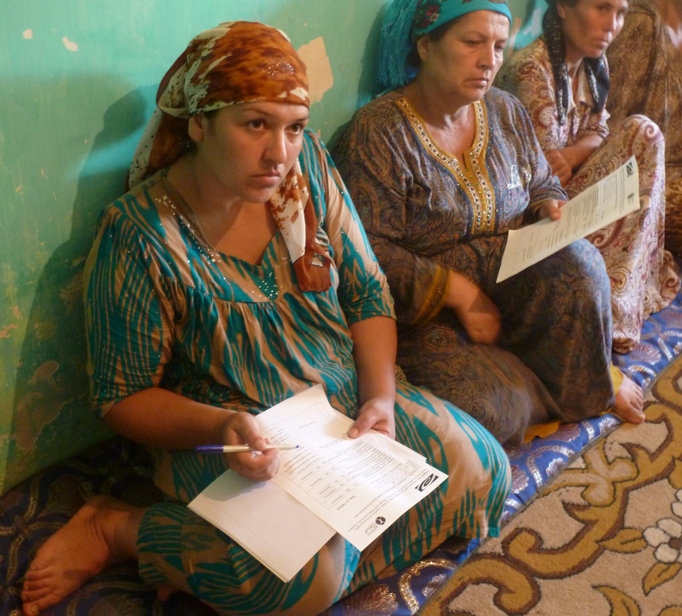
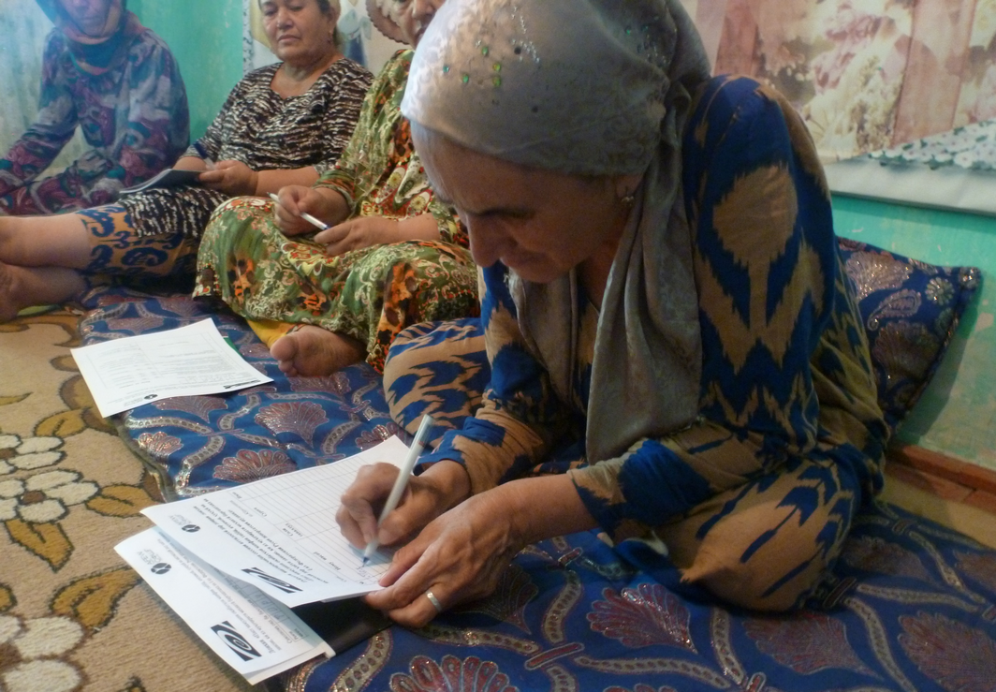
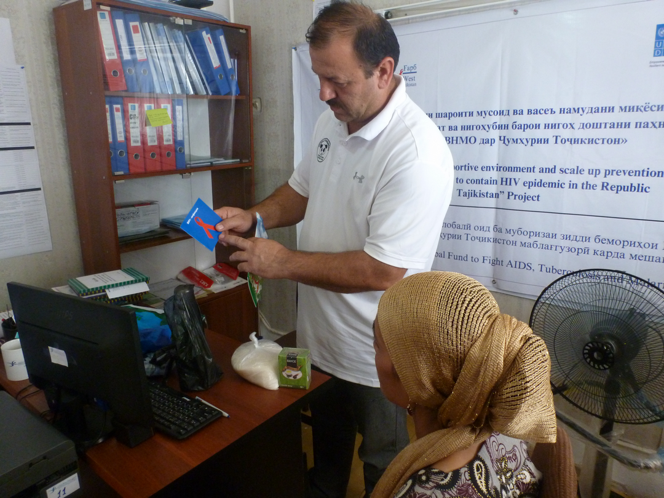
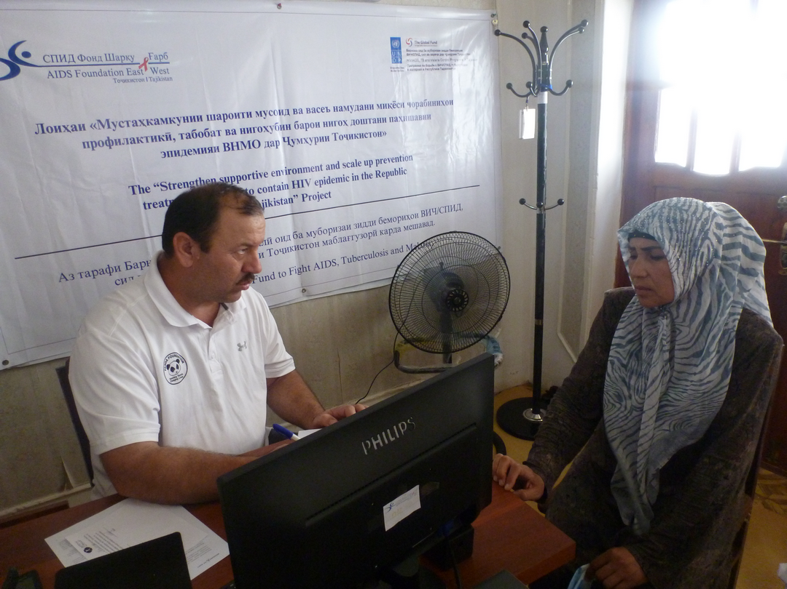
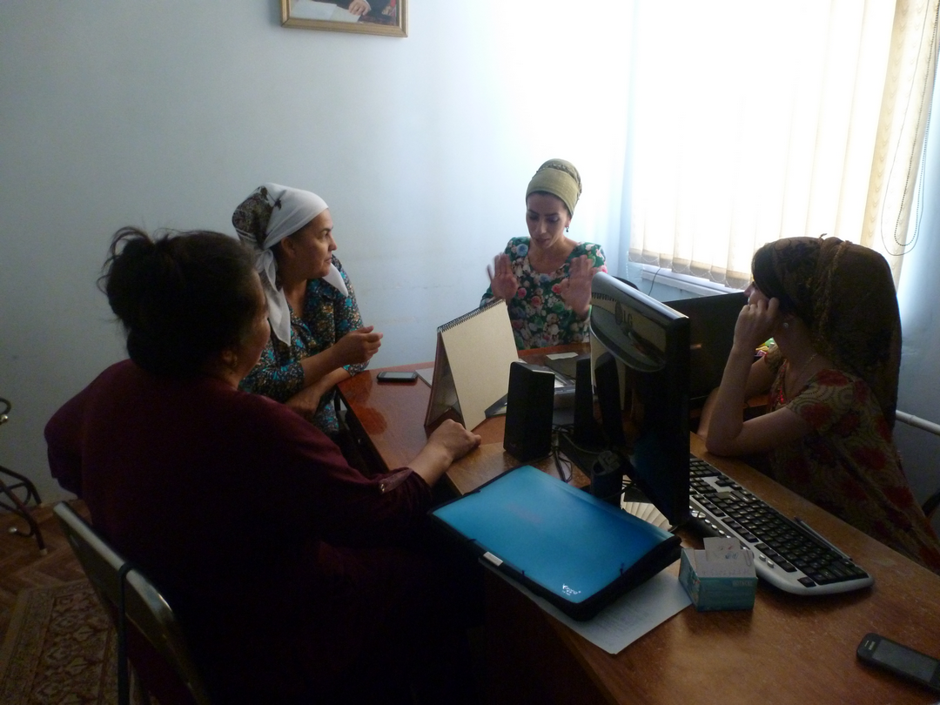
Project results

Slide 15
Lessons learned
Information sessions on reproductive health in the sites of the project helped to reach the women in remote and hard-to-reach areas of the region.
Collaboration with the Adult Learning Center improved women's access to vocational education and assisted in their future employment.
Cooperation with the micro-lending organization increased the economic education of women and increased their access to financial resources.
The availability of evidence-based medical information in AFEW-Tajikistan’s website www.afew.tj contributed to raising awareness of women on socially significant diseases.

Slide 16
Future plans
To launch regional project directed to health protection and raising awareness of potential migrants about their rights and organizations that provide assistance to citizens of Tajikistan being in Russian Federation with purpose of improving their incomes.
Participation in encouraging returned labor migrants to self-employment or creating their own business through short-term trainings.
Development of information materials on the rights and responsibilities of persons planning labor migration.
Promoting informational website www.afew.tj among potential labor migrants.

Slide 17
Thank you for your attention! Visit our site: www.afew.tj and Facebook page: https://www.facebook.com/health.tj
Republican public organization AFEW-Tajikistan
734042 Dushanbe, 11-223, M. Rahimi street
E-mail: tajikistan@afew.tj

